Slide 1
Kubernetes Tech Talk Session
10 Nov 2023

Slide 2
Agenda
What is Kubernetes and its features
Kubernetes Architecture and Components
Pods, statefulsets and deployment
Kubernetes Services
Persistent Volume & Persistent Volume Claim
Secrets and configmap

Slide 3
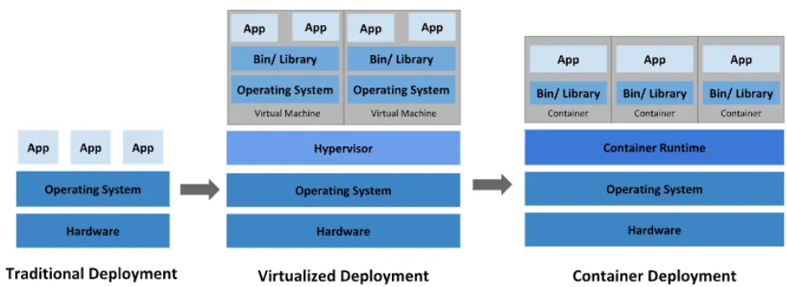
Before Kubernetes :
No isolation of resources Applications are isolated lightweight and quick bootup
Overutilization of resource Better resource utilization and scalable highly scalable and portable
No Load balancing Reduced hardware costs but expensive Inexpensive
What is Kubernetes :
Open-source container orchestration tool
Automates container deployment , container scaling & descaling, container load balancing
Helps you to manage containerized applications in different deployment environments(physical/virtual/cloud/hybrid)
Features of Kubernetes :
High Availability or no downtime
Load Balancing
Automatic Rollbacks & Rollouts
Scalability or high performance
Disaster recovery - backup and restore

Slide 4
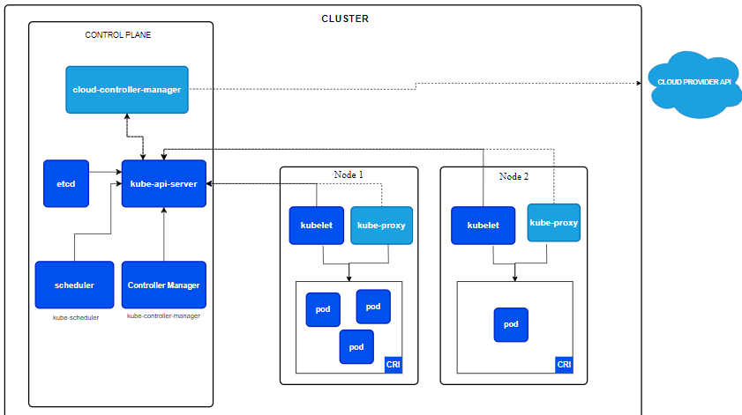
Kubernetes Architecture :

Slide 5
Kubernetes Components :
Control Plane(master) :
API Server (Heart of K8s)
Validation of command/manifest file
Authentication & authorization (users)
processes REST operations, validates them, and updates the corresponding objects in etcd
etcd
etcd is a highly available and consistent key-value store that helps in Kubernetes backing store for all the cluster data
Stores all configuration, user info, app versions, no. of replicas, node info, pod info, connectivity etc.
Scheduler
Kube scheduler is the Kubernetes master component that deals with assigning Pods to the Nodes
Controller Manager
Process that run controller to handle cluster background task
It is a daemon(server) that runs in a continuous loop and responsible for gathering information and sending it to API server
Responsible for changing the current state of cluster to its desired state
Node :
Kubelet :
Responsible for everything on worker node
Gathers Node info(cpu, memory, disk, networking etc.), pod info etc.
Kube-proxy :
route connections to specific/correct pod, also perform load balancing across pods
Handles all network traffic in k8s cluster

Slide 6
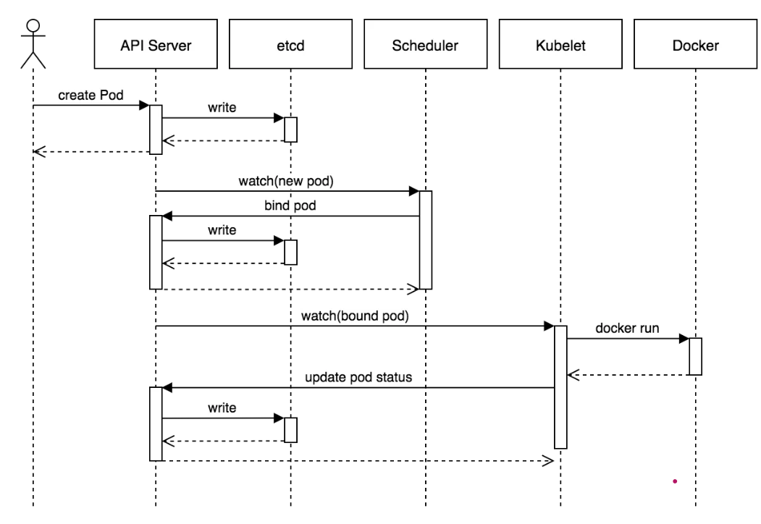
Pod Creation Workflow :
When we create pod how flow goes :
kubectl writes to the API Server.
API Server validates the request and persists it to etcd.
etcd notifies back the API Server.
API Server invokes the Scheduler.
Scheduler decides where to run the pod on and return that to the API Server.
API Server persists it to etcd.
etcd notifies back the API Server.
API Server invokes the Kubelet in the corresponding node.
Kubelet talks to the Docker daemon to create the container.
Kubelet updates the pod status to the API Server.
API Server persists the new state in etcd.

Slide 7
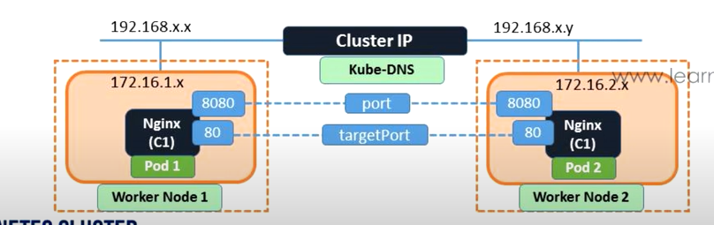
Kubernetes Pod :
Smallest unit of deployment in K8S cluster
Contains one or more running container
Each pod gets its own IP address
New IP address on pod re-creation
Kubernetes Services
Why we need K8s Services ?
Each Pod has its own IP address
Pods are empheral – are destroyed frequently and IP changes
It is not possible to access the application using pod IP every time, that’s where we need k8s service
Services :
K8s Services helps to expose resources- internally (within cluster) as well externally (outside cluster)
Service provided you a stable IP address
Types :
Cluster IP
it exposes resources at cluster level (internally)
By default, your service will be exposed on a ClusterIP
ClusterIP can’t be accessed from the outside world

Slide 8
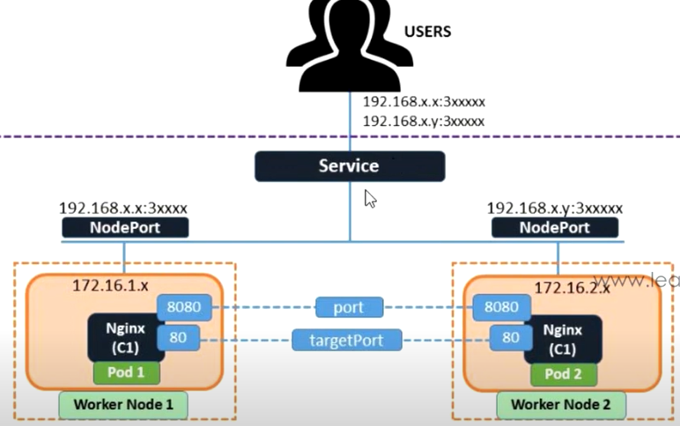
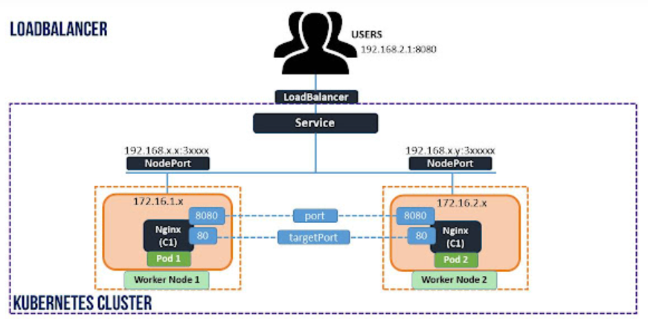
NodePort :
Expose resources externally (it has a range 30000-32767)
NodePort exposes the service on each Node’s IP at a static port (the NodePort)
You can contact the NodePort service from outside the cluster, by requesting <Node IP>:<Node Port>
Load Balancer
Expose resources externally
This service will use or dynamically create an external load balancer like a cloud load balancer when running in the cloud
Cloud provider will provide a mechanism for routing the traffic to the services
we can create network load balancer in cloud . cost will be there.

Slide 9
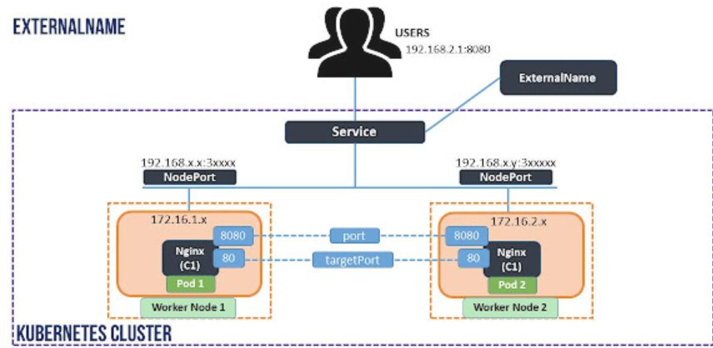
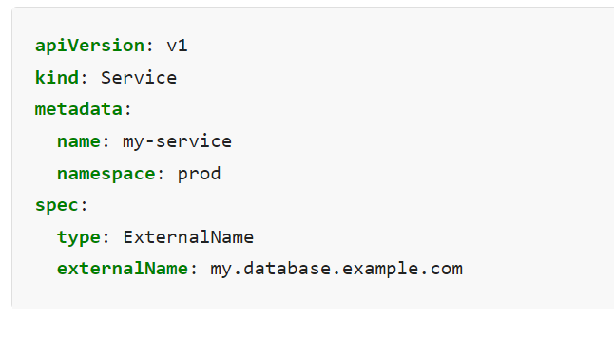
ExternalName :
Services of type ExternalName map a Service to a DNS name
This service used to define the external dns name

Slide 10
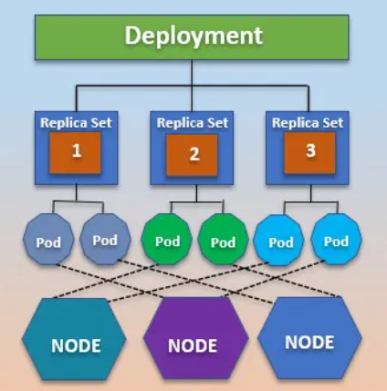
Kubernetes Deployment :
A deployment is an object in Kubernetes that lets you manage a set of identical pods
Ensure that a certain no. of replicas of pods are always running
Easily autoscale your applications using a Kubernetes deployment
Rolling update & Roll back feature is there in Deployment
Stateless applications are deployed using Deployment in K8S

Slide 11
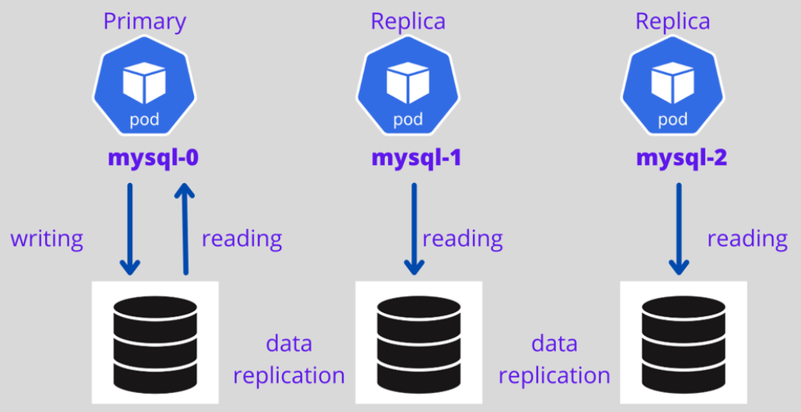
StatefulSet :
Stateful Application: any application that stores the data to keep track of its state, update data based on previous state, applications like databases mysql, mongodb, timescaledb etc.
Stateless application : don’t keep record of state, deployed using Deployment in K8S
StatefulSet :
API-object that’s purpose-built to support stateful application components
It creates a set of identically configured Pods from a spec you supply, but each Pod is assigned a non-interchangeable identity
Every replica of a stateful set will have its own state, and each of the pods will be creating its own PVC(Persistent Volume Claim).

Slide 12
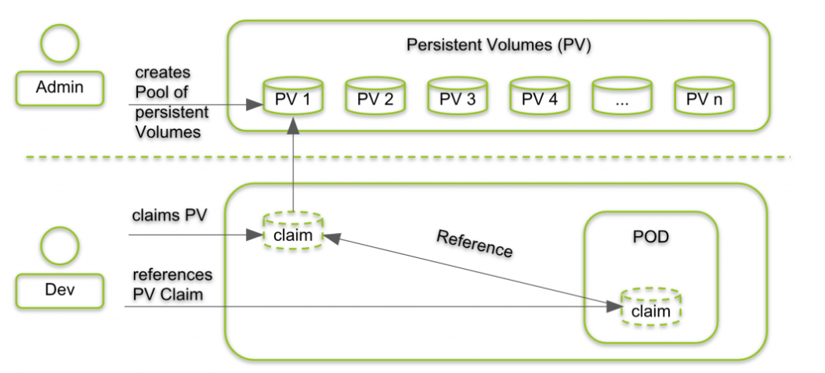
Persistent Volumes and Persistent Volumes claim :
PV and PVC :
Volumes help you persist data even if your container restarts/deleted
Piece of storage provided by an administrator in a Kubernetes cluster
Admin can create PersistentVolume (static provisioning) and developer just use the volume through PVC without understanding of infrastructure
PersistentVolumes are a cluster-level resource like nodes, which don’t belong to any namespace
PVC is a declaration defining the request for storage data usage, which is mounted into a Pod for use
A PersistentVolumeClaim is created by specifying the size and the access mode they require from the PersistentVolume

Slide 13
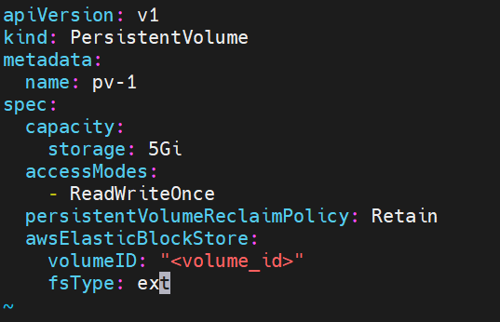
How do we create Persistent Volume :
Yaml file attributes :
Capacity : indicate its storage size in the Capacity attribute
Volumes Modes : Supports 2 volume modes (FileSystem & Block)
Access Modes :
1. ReadOnlyMany : multiple pods will use that pvc to read the data
2. ReadWriteOnce : one pod will use that storge to read and write data
3. ReadWriteMany : multiple pods will use that pvc to read and write data both
ReclaimPolicy
1. Retain : volume will retain even if pv get deleted
2. Recycle : meaning the data can be restored later after getting scrubbed
3. Delete : associated storage assets (such as AWS EBS, GCE PD,..) are deleted
Mount Options : K8S administrators can specify mount options for mounting persistent volumes on a node.

Slide 14
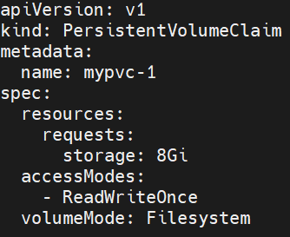
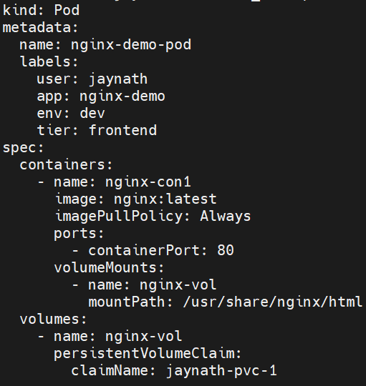
How do we create persistent volume claim :
YAML file attributes :
accessModes : same as volume
volumeMode : same as volume
Resource : requests for storage resource with specific size
Using PVC in a pod :
Volumes attribute : Specify persistentVolumeClaim

Slide 15
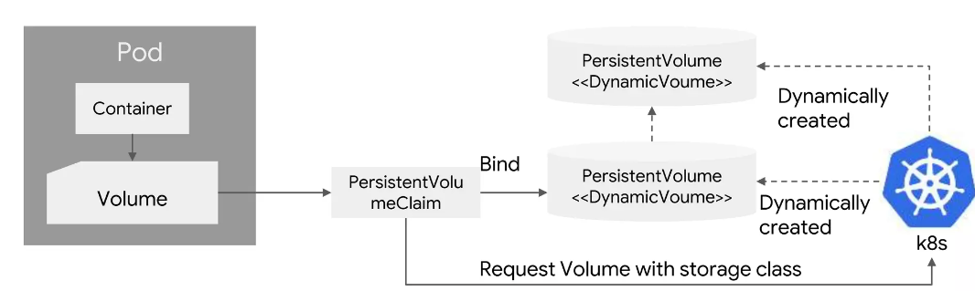
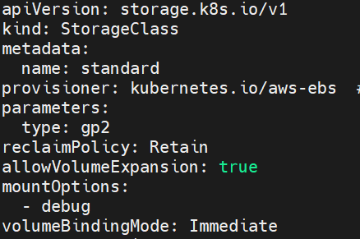
Dynamic Volume Provisioning :
From k8s 1.6, without manual provisioning of Persistent Volume, K8S can dynamically create volume based on PersistentVolumeClaim(and storage class)
Dynamic volume provisioning happens through storage class
Storage Class :
Provisioner : determines the volume plug-in used by the storageClass.
Several plug-ins such as AWS EBS and GCE PD are available for different storage providers.
Parameters : contain available configurations accepted by the provisioner.
ReclaimPolicy : retain or delete
volumeBindingMode : Immediate/ WaitForFIrstConsumer
In PVC you have to mention that storage class name like (storageClassName: <name>)

Slide 16
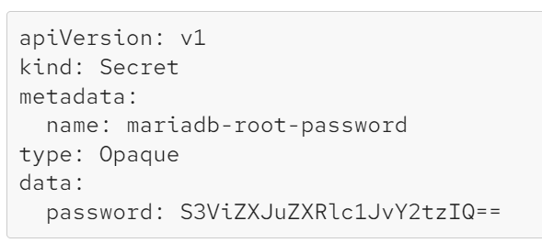
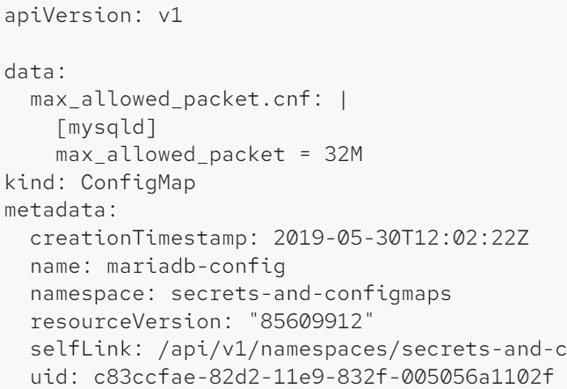
Secrets & Configmap
Secrets are a Kubernetes object intended for storing a small amount of sensitive data.
Secrets are stored base64-encoded within Kubernetes, so they are not wildly secure.
Configmap
ConfigMaps are like Secrets. They can be created and shared in the containers in the same ways.
The only big difference between them is the base64-encoding obfuscation.
ConfigMaps are intended for non-sensitive data—configuration data—like config files and environment

Slide 17


